Slide 1
FIN 557 Project - Group 17
Impact of Covid on Bankruptcy
Jason Chang Chien, Wei-Yu Chen, Ching-Che Chi, Pranav Ganapathy Subramanian, Gamanash Kommineni, Ana Telia, Sabelo Zwane

Slide 2
Research Questions
Analyzing the financial data from WRDS during the FY 2017-2023 to assess the impact of COVID on bankruptcy
Analyzing z-score to evaluate its performance for predicting the bankruptcy
Analysis of Bankruptcy
Analysis of Z-score
Compared number of firms
Pre / During / Post Covid-19
Which Industry was impacted the most
Which State was impacted the most
Effect of Covid-19 cases on number of bankruptcy
Calculated Z-Score
Evaluated its performance

Slide 3
Analysis of Bankruptcy

Slide 4
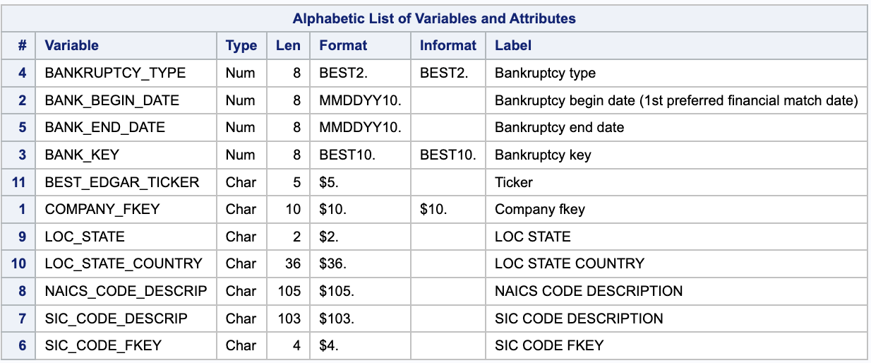
Data Source - WRDS
Data 1: Bankruptcy Firms from 2017 to 2023
Path: Get Data - Audit Analytics - Corporate + Legal - Bankruptcy Notification

Slide 5
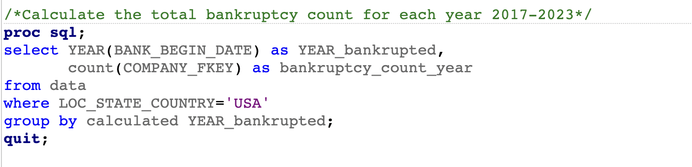
Compared number of firms (Pre / During / Post Covid-19)
SAS Code
Use YEAR() function to extract year from date information
Filter the country variable to include only USA firms and group by year

Slide 6
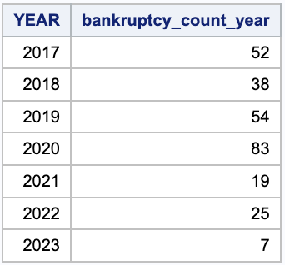
Compared number of firms (Pre / During / Post Covid-19)
Output Table
Result
Pre-Covid (2019) : 54
During Covid (2020): 83
Post-Covid (2021): 19
The number of bankruptcy firms had a steep increase during the Covid-19 Pandemic as expected.

Slide 7
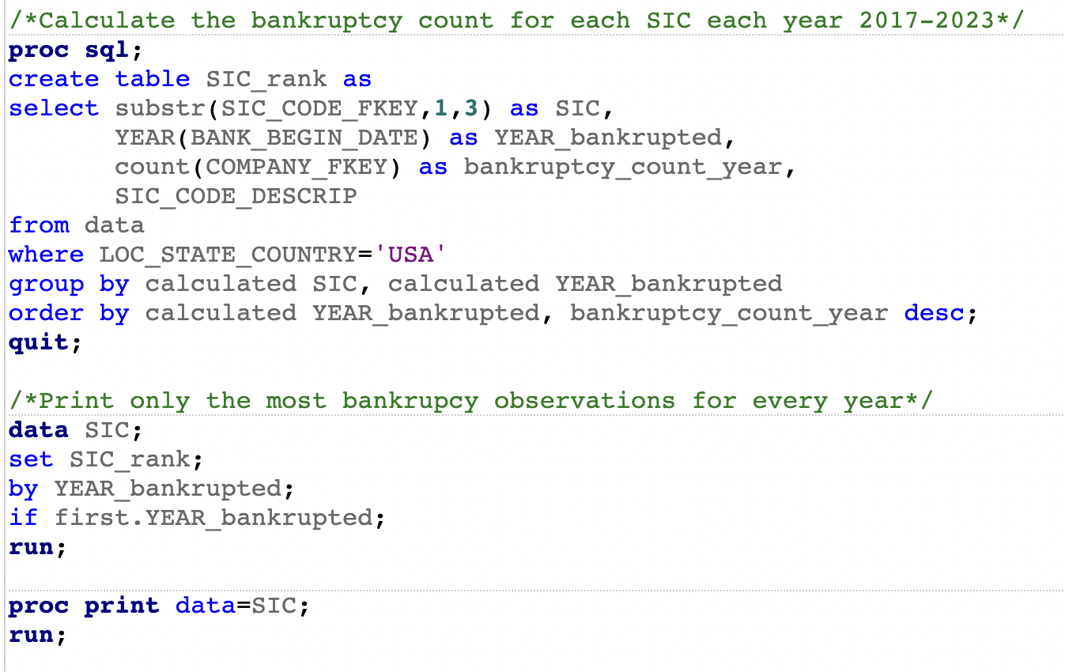
Which Industry was impacted the most
SAS Code
Using substr function to extract the first three letters of the SIC code
Group by SIC and Year
Order by Year and no. of bankruptcy
Only choose the first row of each year to include the most impacted Industry

Slide 8
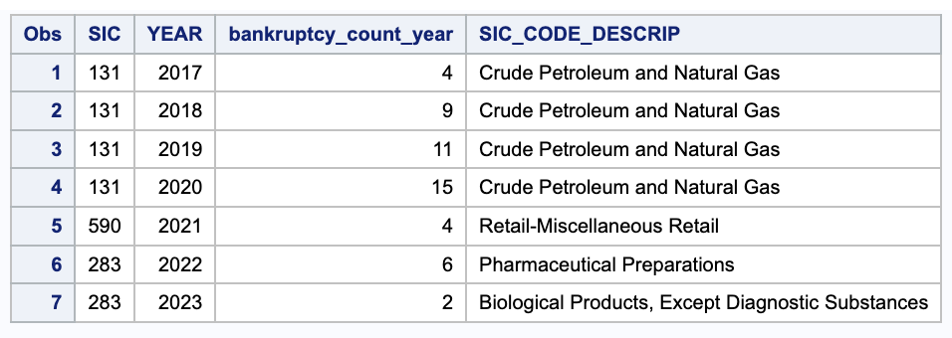
Which Industry was impacted the most
Output Table
2017 to 2020: the SIC code starts with 131 was the most impacted one, which was Crude Petroleum and Natural Gas Industry
2021: the SIC code starts with 590 was the most impacted one, which was Retail - Miscellaneous Retail Industry
2022 to 2023: the SIC code starts with 283 was the most impacted one, which was Drugs Industry
Result

Slide 9
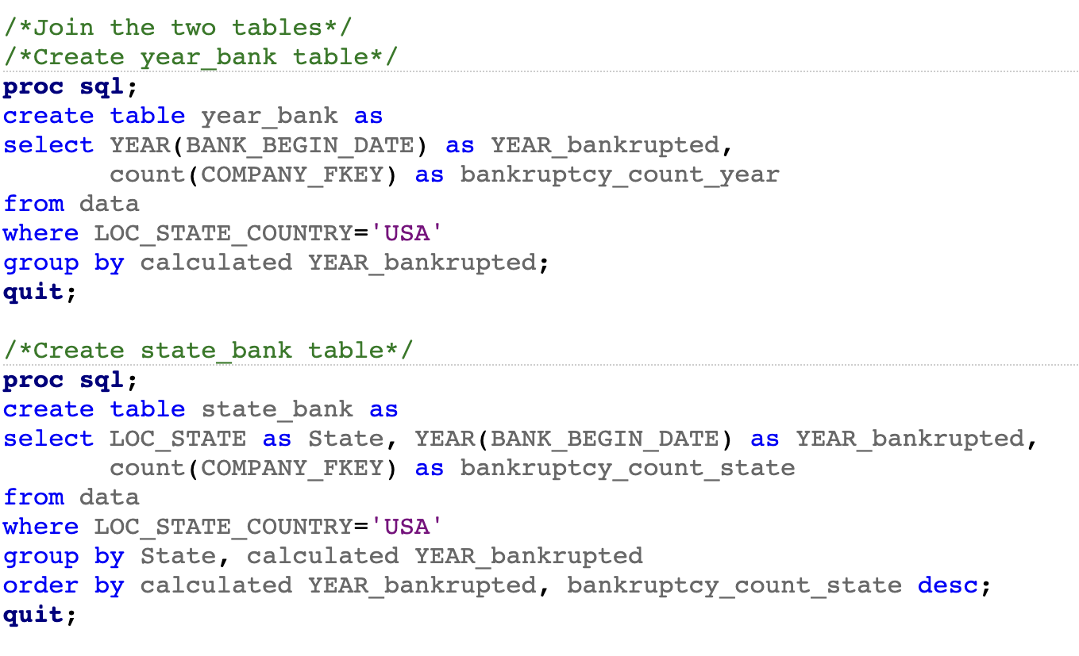
Which State was impacted the most
SAS Code
Create two tables
Year_bank: calculated the total number of bankruptcy cases filed in each financial year from 2017 to 2023
State_bank: calculated the bankruptcy cases filed in each state for the years 2017-2023

Slide 10
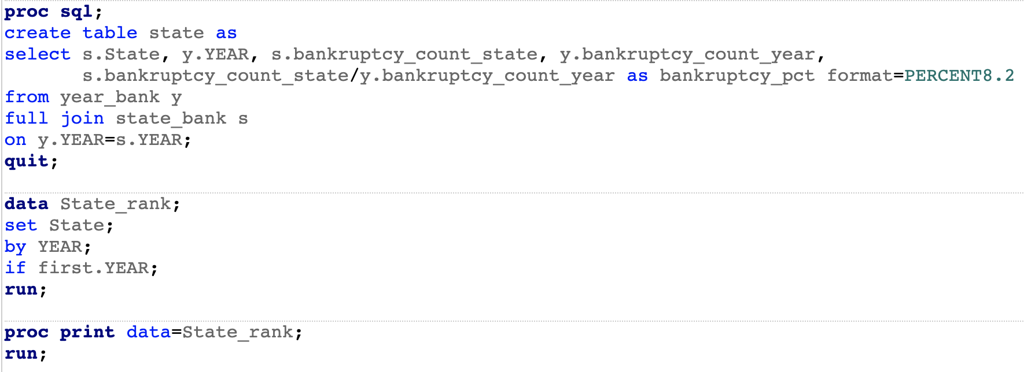
Which State was impacted the most
SAS Code
Join two tables and calculate the percentage of the case each state compared to total
Use Year to join the tables
Only choose the first row of each year to include the most impacted State

Slide 11
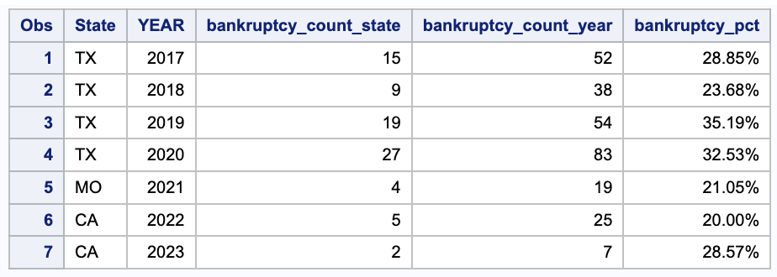
Which State was impacted the most
Output Table
2017 to 2020: Texas was the most impacted state, which accounted for about 24% to 35%
2021: Missouri was the most impacted state, which accounted for 21%
2022 to 2023: California was the most impacted state, which accounted for 29%
Result

Slide 12
What is the ratio of bankruptcy vs total number of firms for 2020
State/Province | Data Year - Fiscal | Frequency Count | Ratio_firm_bankrupt_pct
OK | 2020 | 4 | 5.6
TN | 2020 | 4 | 4.4
NV | 2020 | 4 | 4.4
TX | 2020 | 27 | 4.1
LA | 2020 | 1 | 2.3
CO | 2020 | 5 | 2.3
Output Table
Result
For 2020, Texas not only has the greatest percentage of corporations that filed for bankruptcy but also the ratio of companies that went bankrupt to the total number of companies is among top 5 within the country

Slide 13
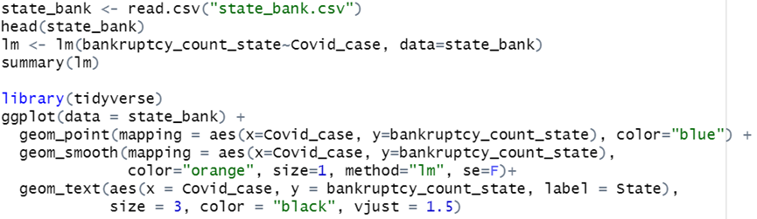
Linear regression between COVID-19 and bankruptcy by State in 2020
R code
Use the data from state_bank table and Covid-19 cumulative cases number from CDC official website
Run linear regression regression to analyze the relationship between Covid cases and bankruptcy numbers, and then create a scatter plot

Slide 14
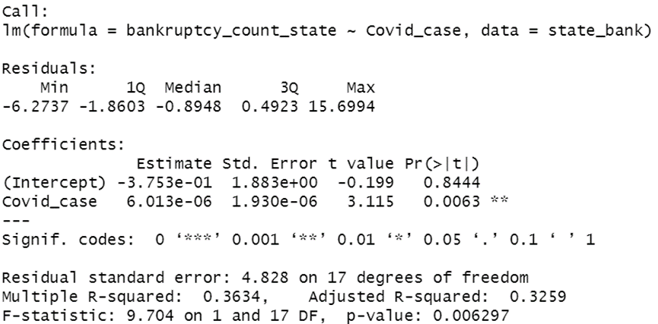
Linear regression between COVID-19 and bankruptcy by State in 2020
Statistic Summary
p-value for the Covid_case is 0.0063
There is a strong evidence of a statistically significant relationship between Covid cases and bankruptcy numbers.
Outcome

Slide 15
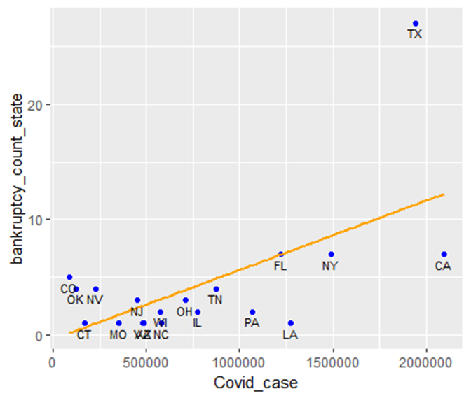
Linear regression between COVID-19 and bankruptcy by State in 2020
Result
There is a positive relationship between Covid cases and state bankruptcy number
As the number of Covid cases increases in a state, the number of bankruptcies also tends to increase

Slide 16
Analysis of Z-score

Slide 17
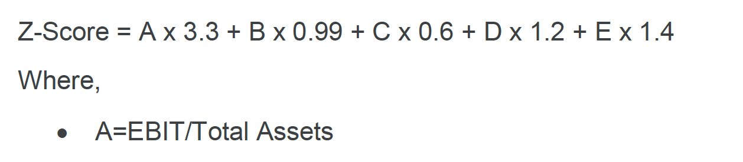
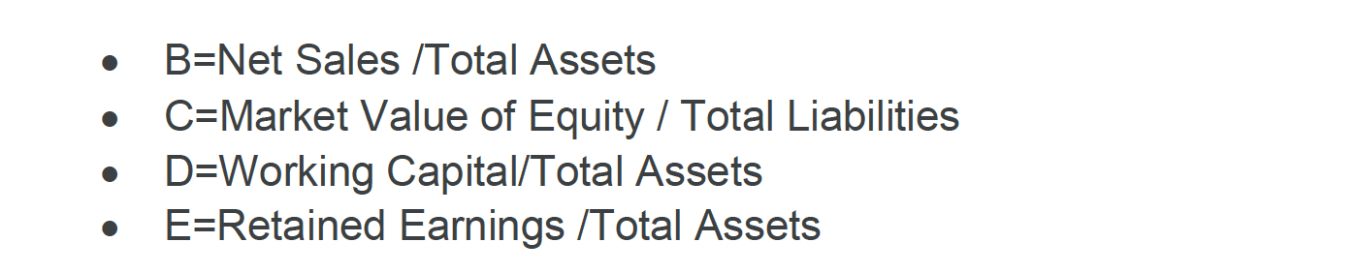
Z-Score
Z-score is a weighted average accounting ratios calculated using the following formula:

Slide 18
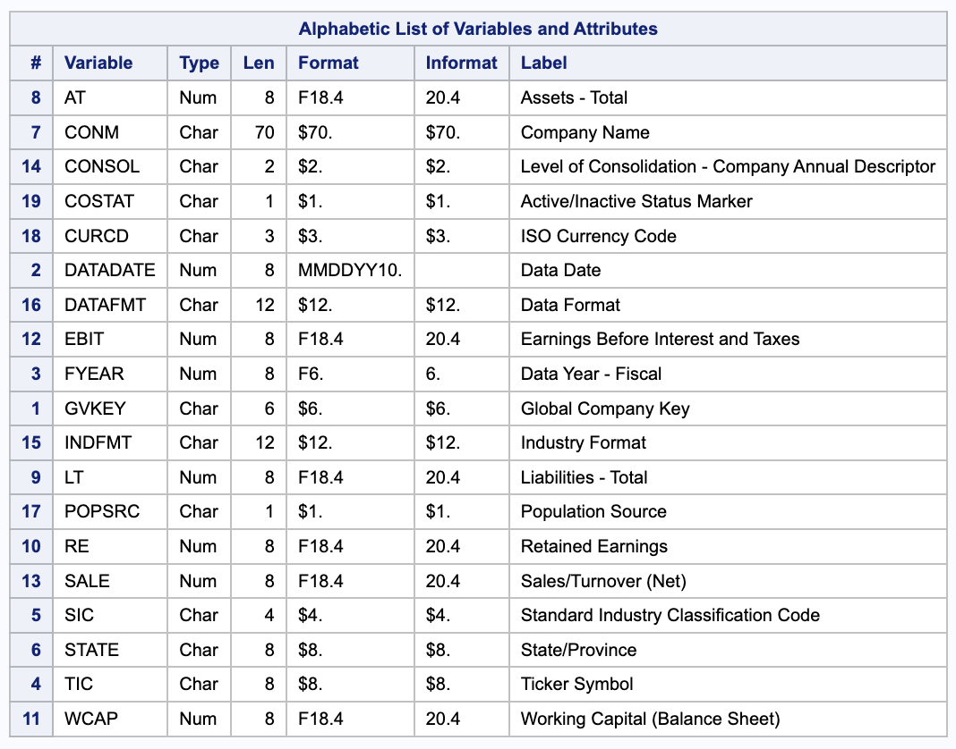
Data Source - WRDS
Data 2: Data from Financial Statements from 2017 to 2023
Path: Get Data - Compustat - Capital IQ - Compustat - North America - Fundamentals Annual

Slide 19
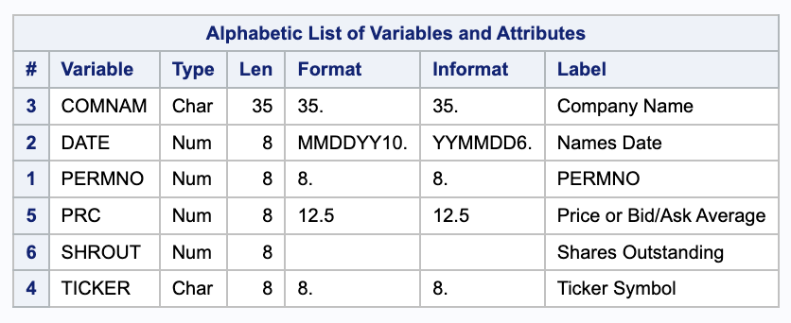
Data Source - WRDS
Data 3: Share price and Shares outstanding from 2017 to 2023
Path: Get Data - CRSP - Annual Update - Stock/Security Files - Daily Stock File

Slide 20
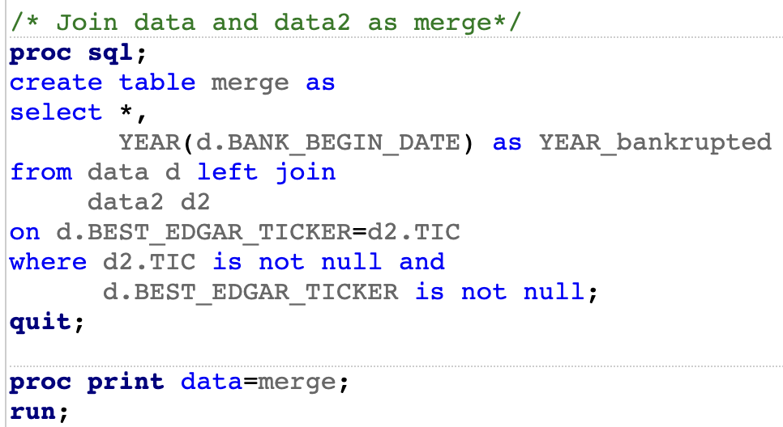
Merge the financial data with bankruptcy data
SAS Code
Use left join to merge two tables.
Left table: Bankruptcy data
Right table: Financial Statements data
Use Ticker to join the tables
Filter out the missing value
Notes:
We are trying to keep the bankruptcy data

Slide 21
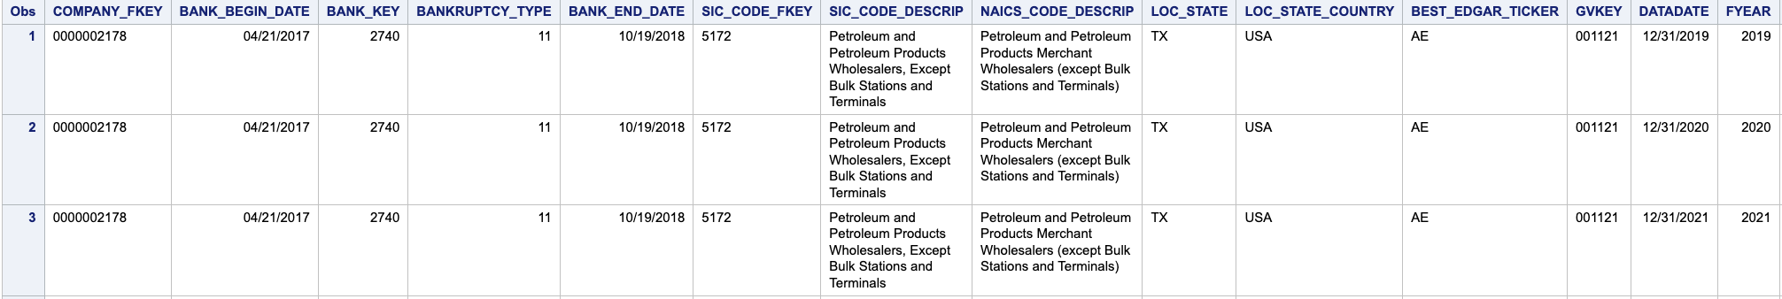
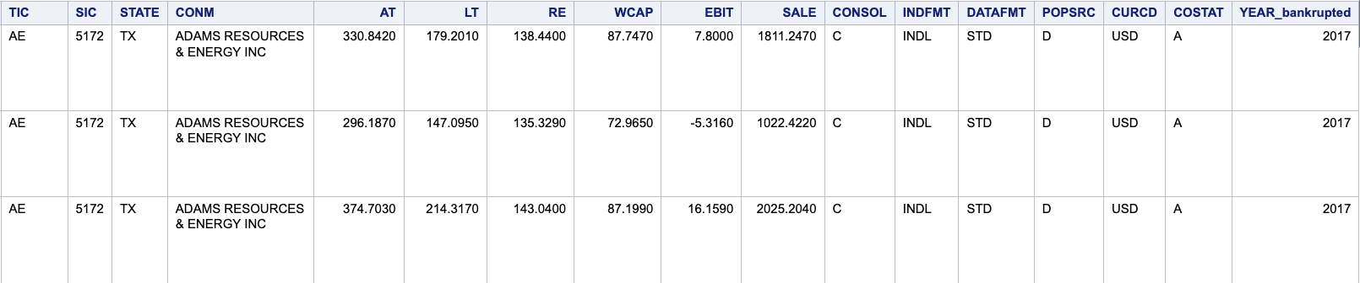
Merge the financial data with bankruptcy data
Output Table: Merge

Slide 22
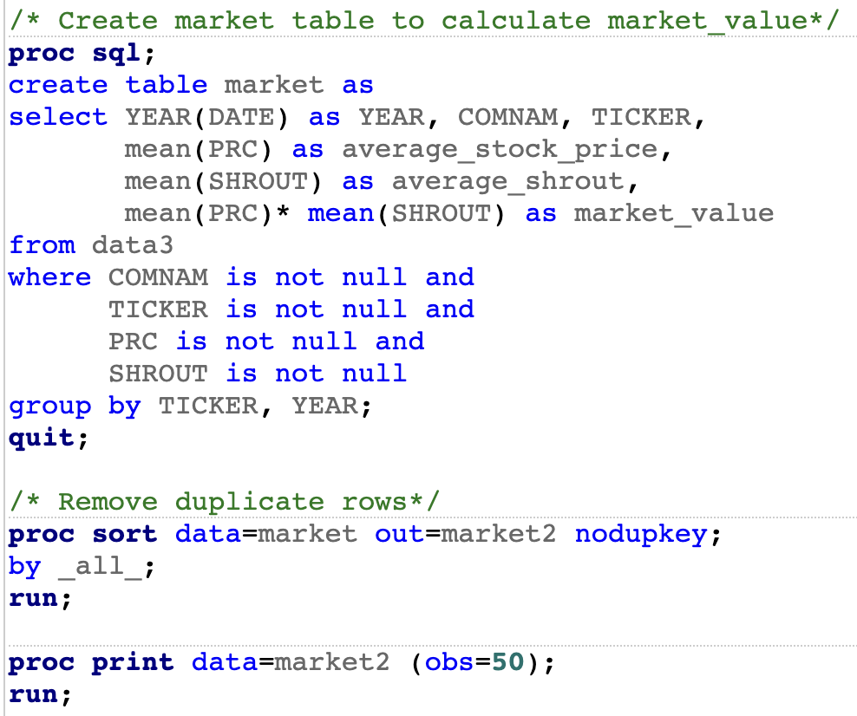
Calculate the Share price and Shares outstanding
SAS Code
We removed duplicate rows using proc sort nodupkey function
We averaged the monthly share price and shares outstanding to use as the annual data
Market Value of Equity = Share price * Shares outstanding
Notes:
Also filter out the missing value

Slide 23
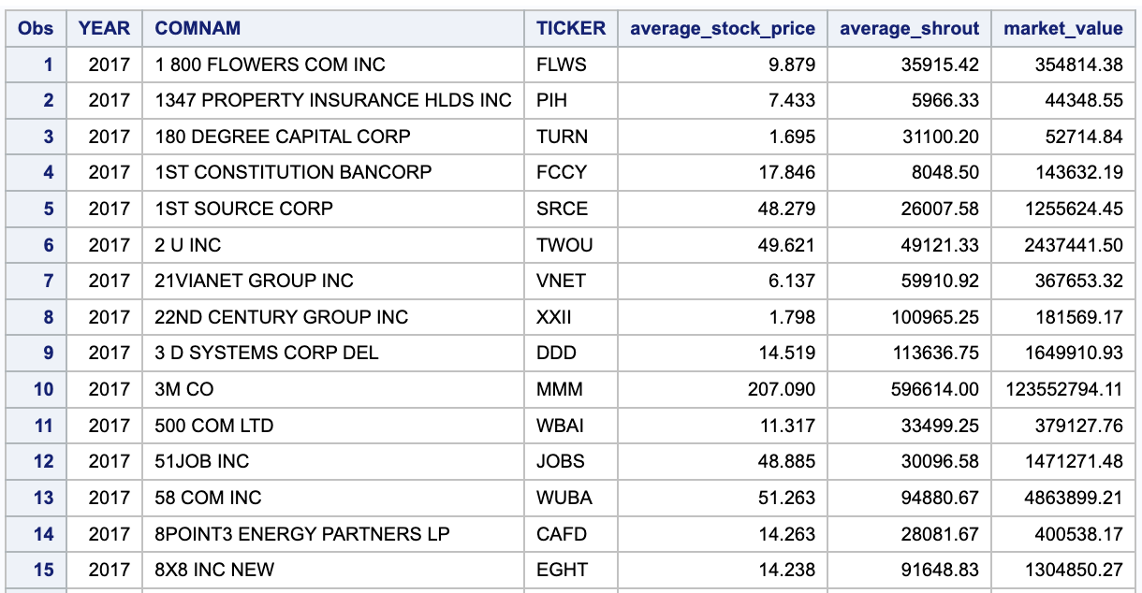
Calculate the Share price and Shares outstanding
Output Table
Market2
Notes:
Market value is used of calculating C in Z-score

Slide 24
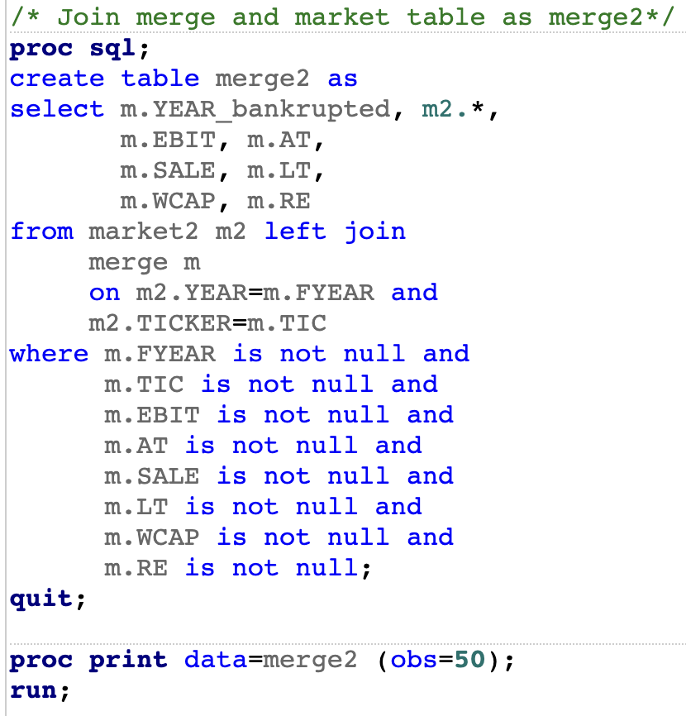
Merge the “Merge” table with “Market2” table
SAS Code
Use left join to merge two tables.
Left table: Market2
Right table: Merge
Use Ticker and Year to join the tables
Filter out the missing values

Slide 25
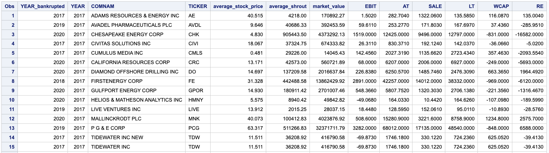
Merge the “Merge” table with “Market2” table
Output Table: Merge2

Slide 26
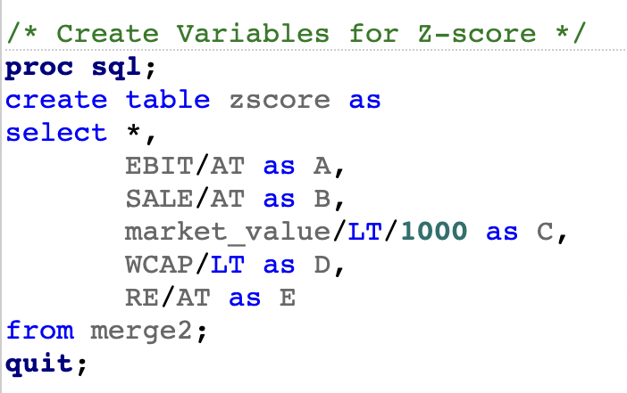
Create variables to calculate Z-Score
SAS Code
Create Ratios needed to calculate the Z-score

Slide 27
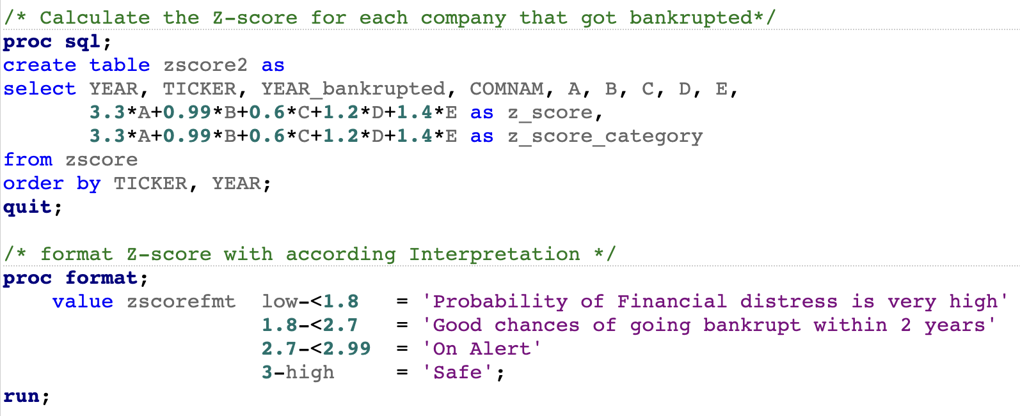
Create variables to calculate Z-Score
SAS Code
Calculate Z-score within proc sql
Use proc format to assign interpretations to Z-score values

Slide 28
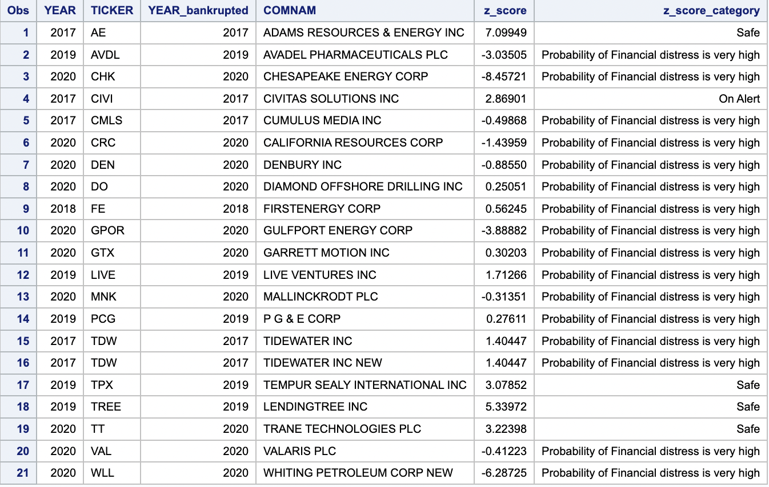
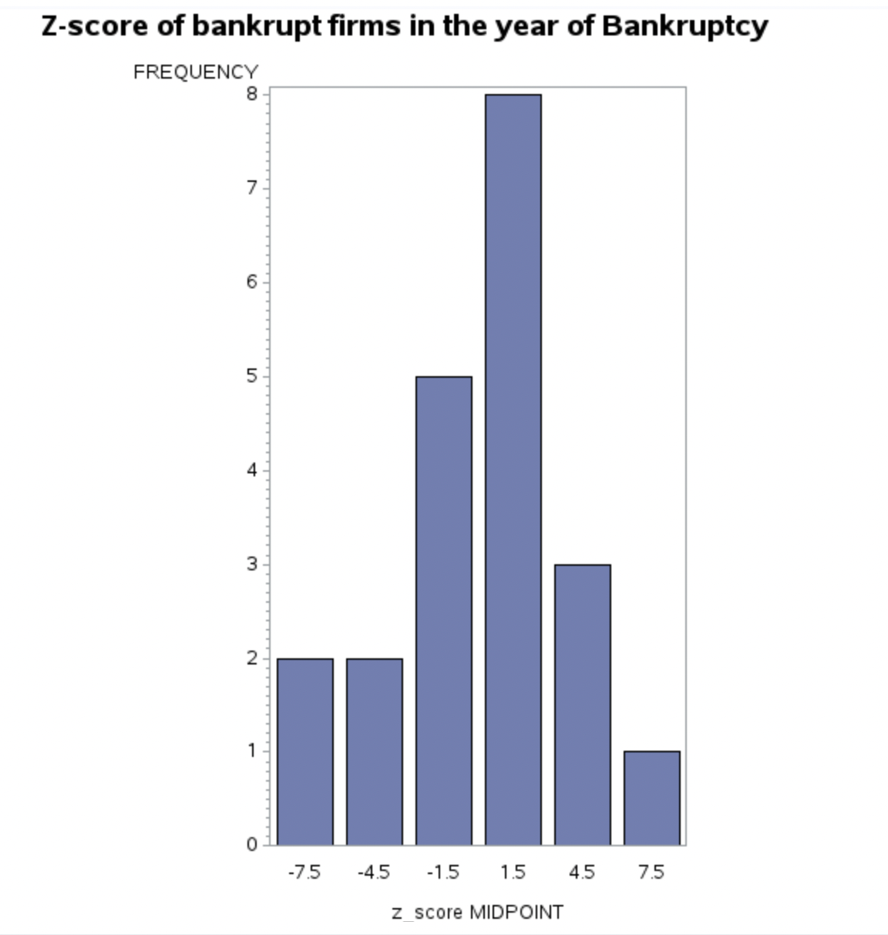
Relationship between Z-score and actual bankruptcy data
Note: We are evaluating based on the year of bankruptcy, not based on the beginning of bankruptcy

Slide 29
Conclusion

Slide 30
Conclusion
Effect of Covid-19 on Bankruptcy
Is Z-score reliable?
The total number of Bankruptcies were increased in 2020
The Regression Analysis is consistent with our assumption that the increase in the number of Bankruptcies was partly caused by the Pandemic
Z-Score is mostly consistent with the reality
We can not evaluate performance of the Z-score precisely due to the small sample size

Slide 31
Thank you for your attention!
We value your feedback
Please share your comments, or suggestions with us

